Slide 1
Text mining and analysis
Zoe Borovsky, Ph.D.
UCLA: Librarian for Digital Research and Scholarship
zoe@library.ucla.edu

Slide 2
Text mining/analysis; what’s the difference?
Voyant/Voyeur
Web-based
Text analysis and visualization
Mallet
Text mining
Application
Free
Free
Notes:
Tools that allow faculty/students to use computational methods.
There are much more sophisticated tools and methods, but we’re looking for quick and easy ways of testing hypotheses and exploring materials.

Slide 3
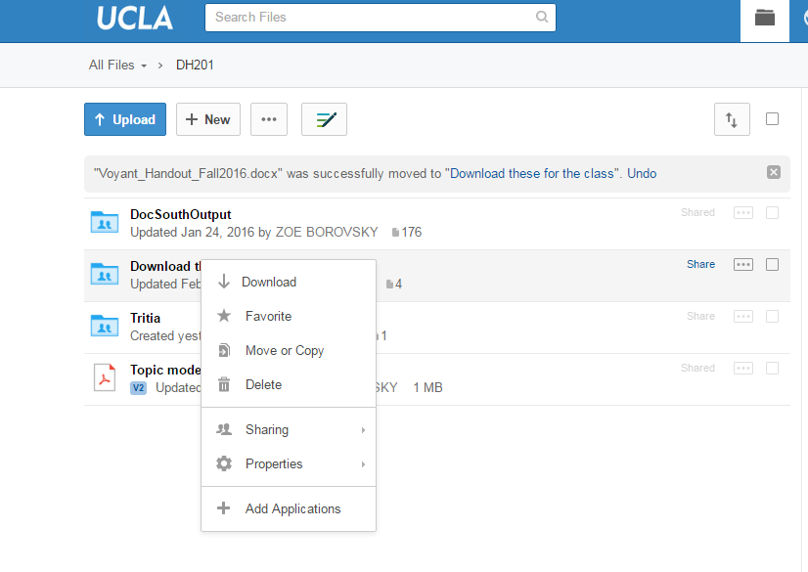
Handout and data sets download:
https://ucla.box.com/v/DH201
Folder will have:
1. Texts.zip
2. Voyant handout
Texts.zip

Slide 4
Two levels of analysis
Micro-level
Macro-level
Exploring the words within a text for particular patterns
Clustering texts in a large corpus.
Mallet
Voyant
Comparing a micro-level pattern with another corpus or across an entire corpus

Slide 5
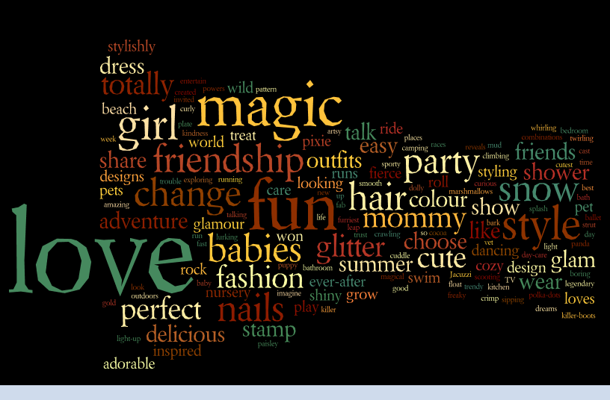
Micro-level
Exploring the words within a text for particular patterns
Words Used in Advertising for Girls' Toys
The most common words used to advertise girls' toys, like Barbie, Bratz Dolls, My Little Pony, Littlest Pet Shop, Zhu Zhu Pets, Polly Pocket, Easy Bake, Monster High, and Moxie Girl
Notes:
This is what we think of as text-analysis.

Slide 6
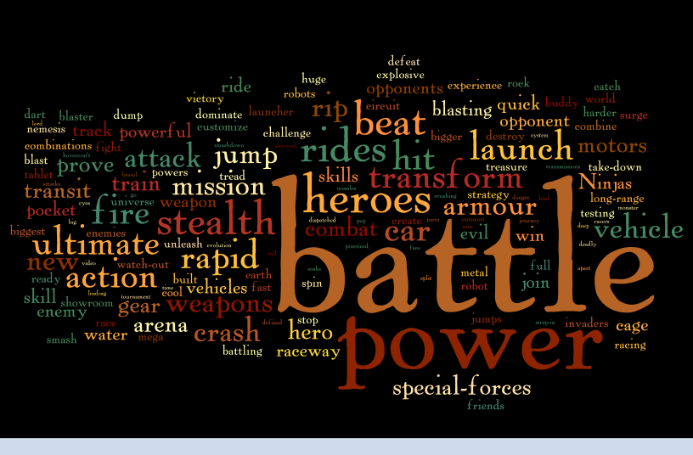
Macro-level
Comparing a micro-level pattern across an entire corpus
Notes:
Moving towards a macro-level analysis. Even simple tools can help you identify patterns and support your argument.

Slide 7

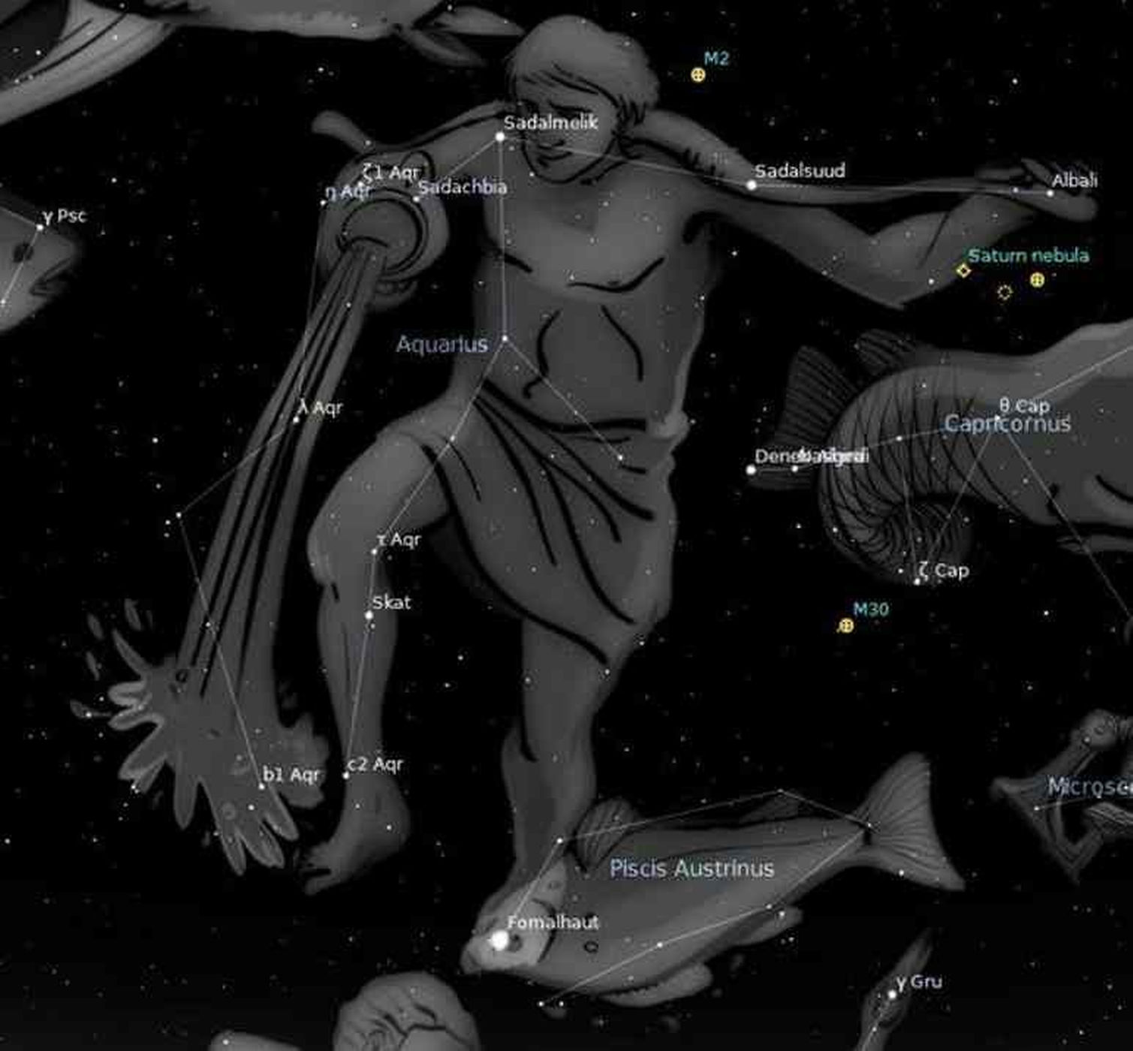

Patterns: verbal and visual
Frequency, repetition, word associations

Slide 8
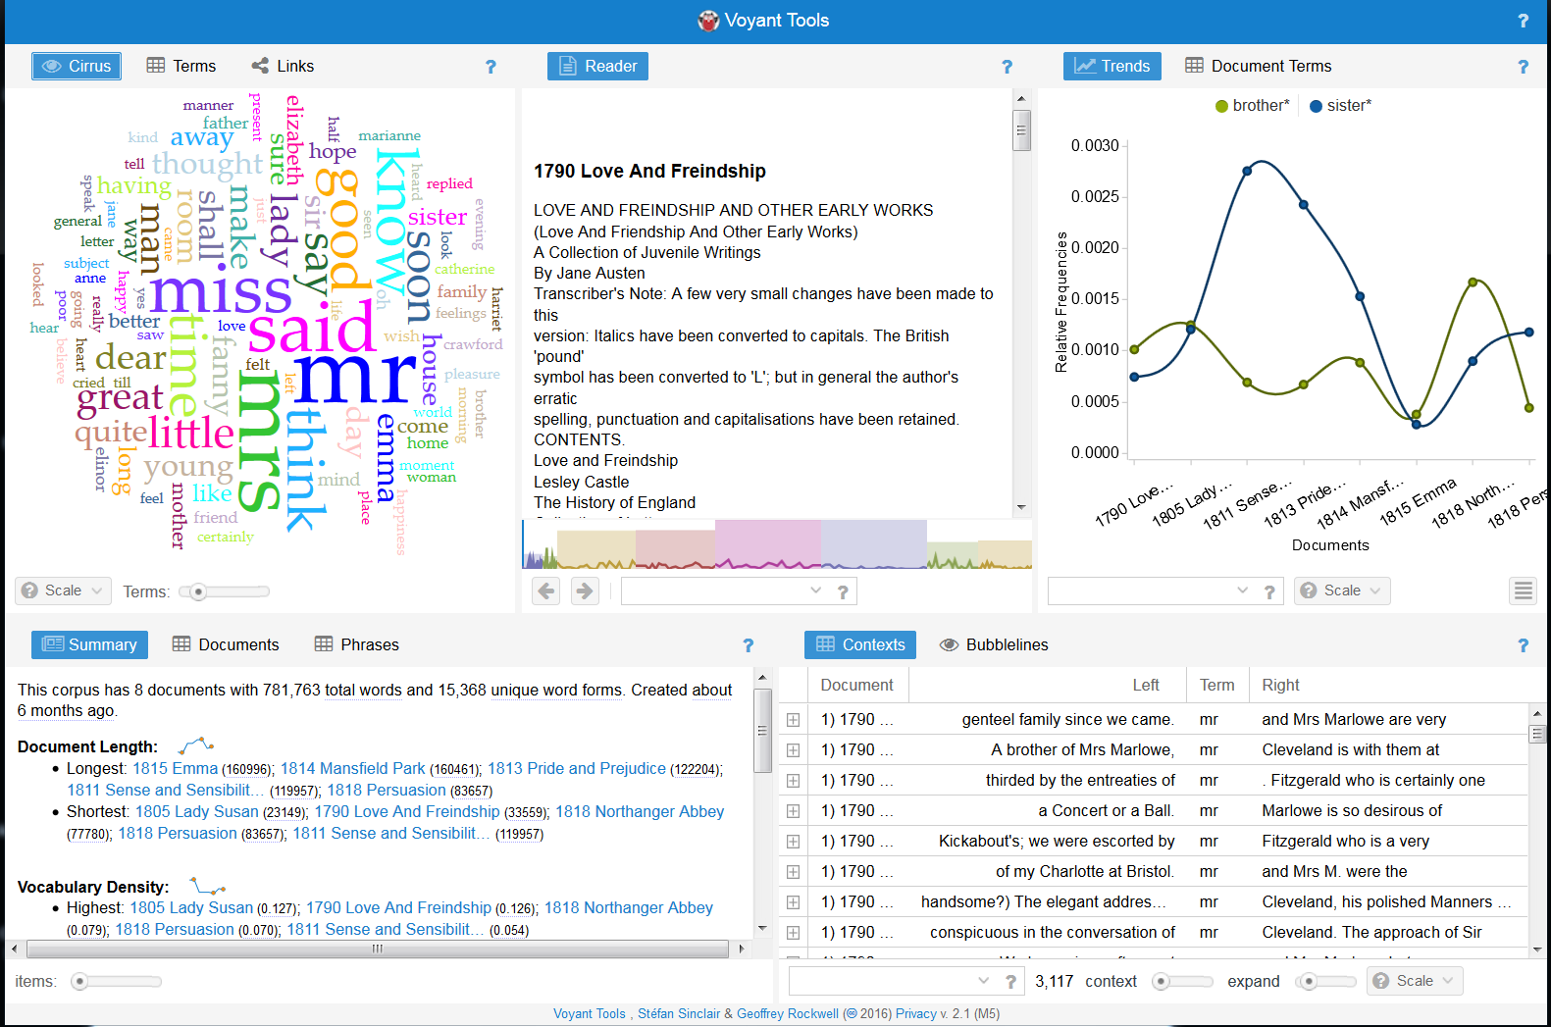
We’re going to use text analysis to explore word patterns in Jane Austen’s novels
Voyant/Voyeur
Does Austen refer more often to sisters or brothers in her novels?

Slide 9
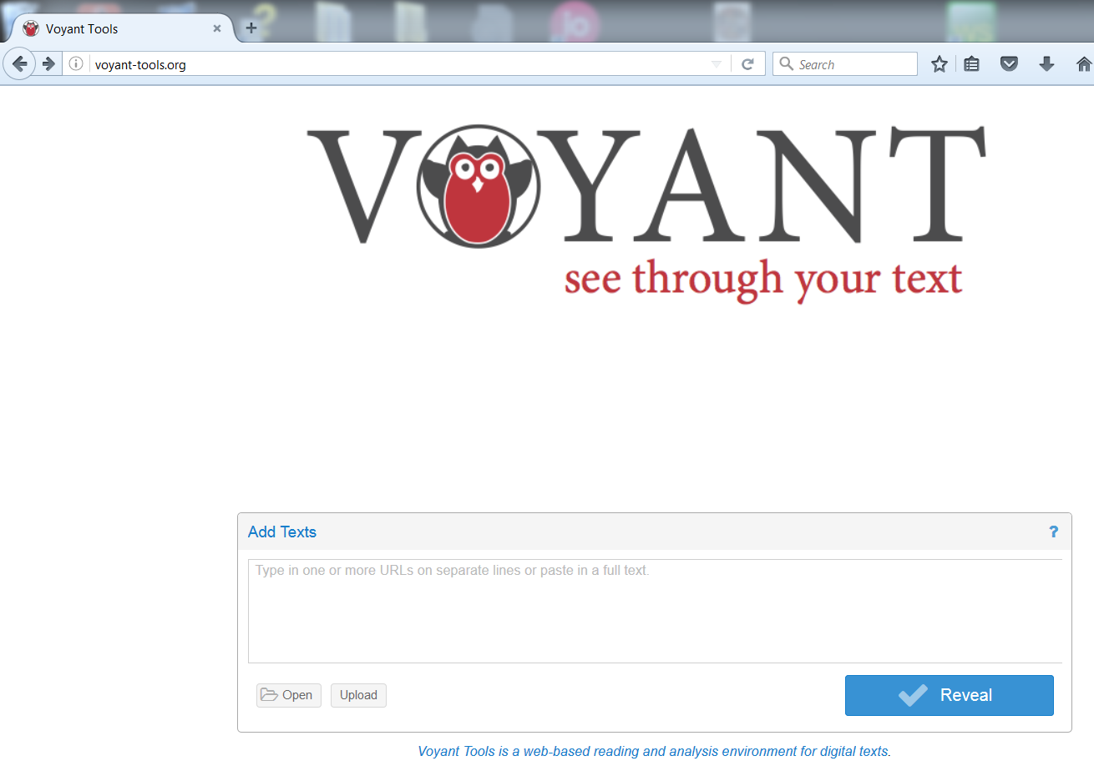
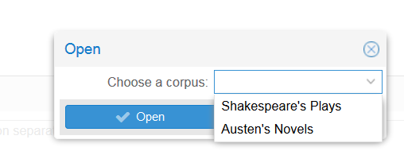
Open a web-browser, Firefox
Go to: http://www.voyant-tools.org
Open

Slide 10
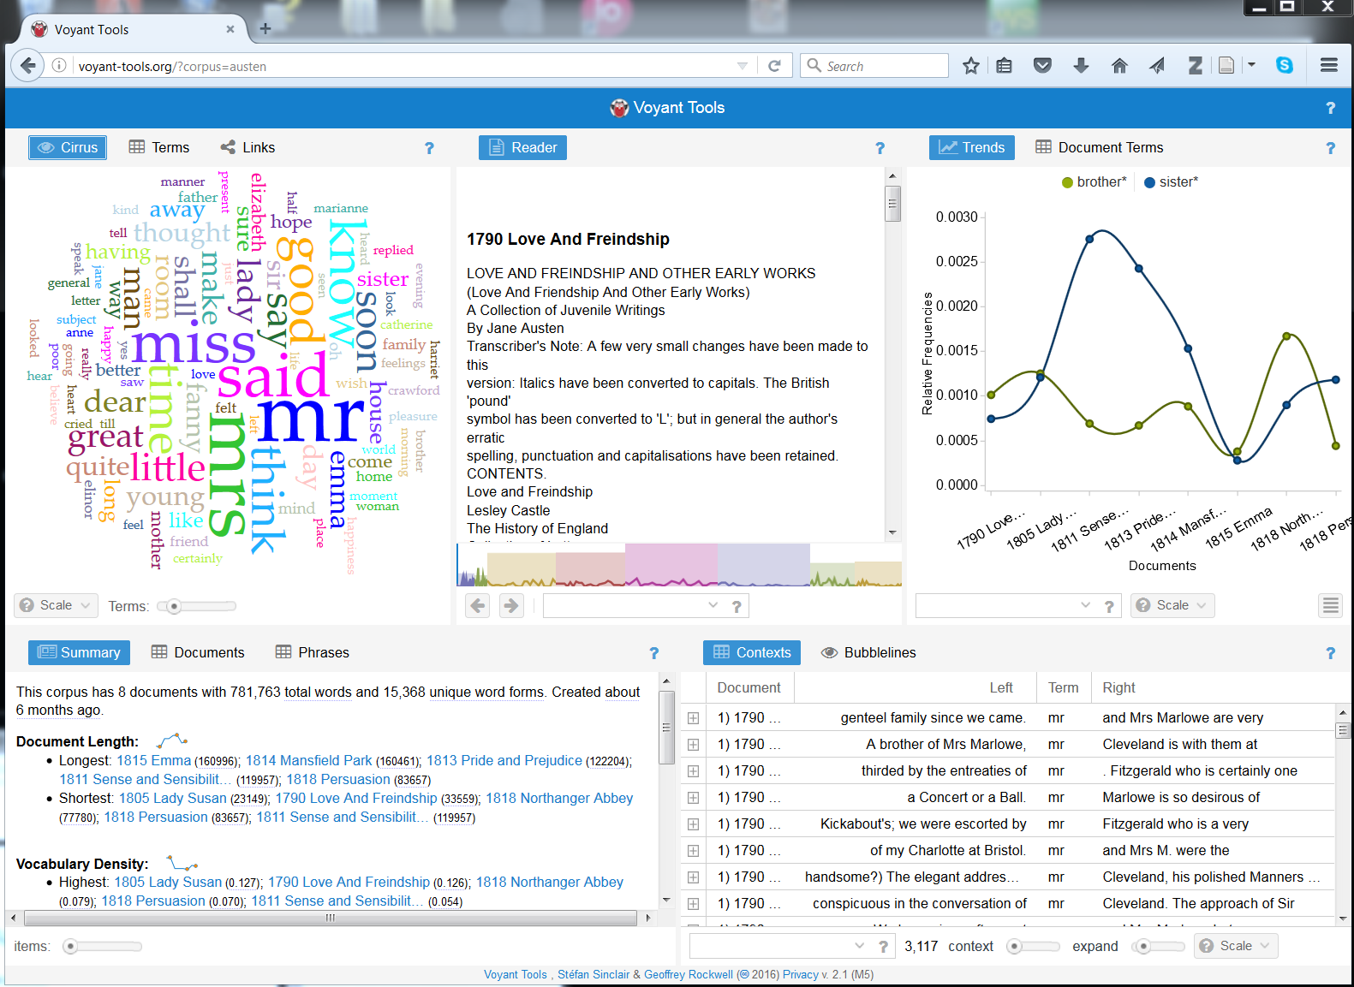
1
2
3
4
5
Let’s explore the interface – and then learn how to search for “brother” and “sister” across all novels.

Slide 11
Searching on a specific term or terms
1
2

Slide 12
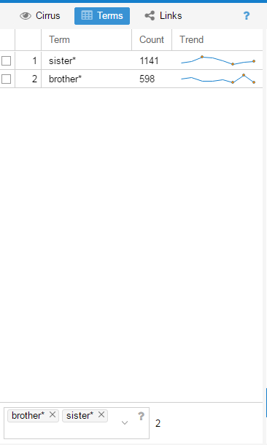
Then choose the checkboxes
Type here

Slide 13
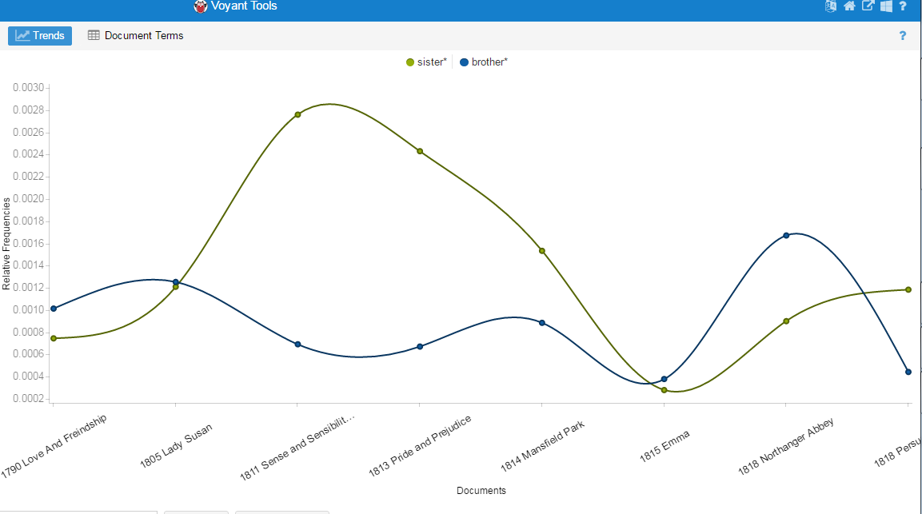
Adjust the panels so you view a nice timeline.
Which novel has the most mentions of “sister”?
Of “brother”?
What does the * mean?
We could explore this further, compare words near “sister” with words near “brother”.

Slide 14
Upload your own Texts
Voyant

Slide 15
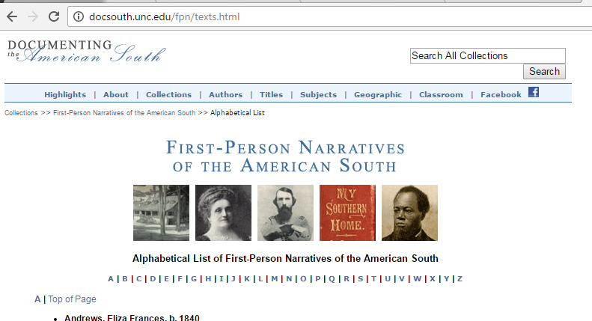
Handout and data sets download:
https://ucla.box.com/v/DH201
You won’t need to unzip these, yet.
Texts.zip
150 texts!!

Slide 16
Explore the corpus
What kinds of questions might you want to ask about these texts?

Slide 17
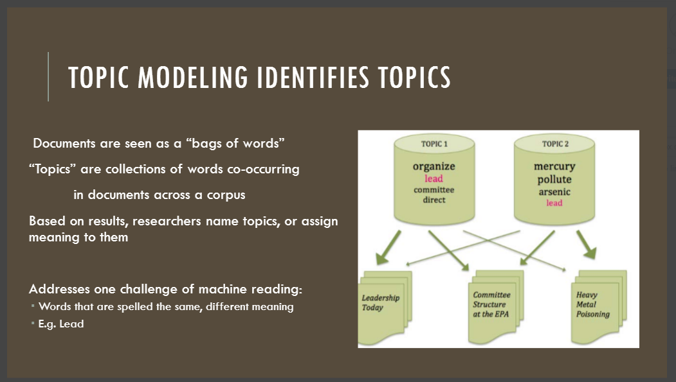
Text mining with Mallet
Mallet

Slide 18
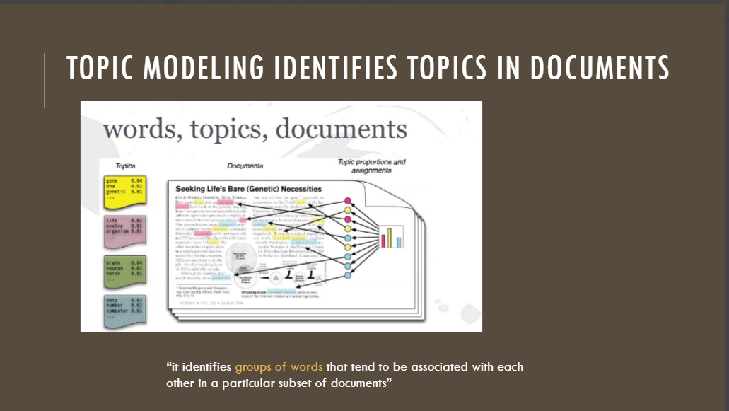

Slide 19
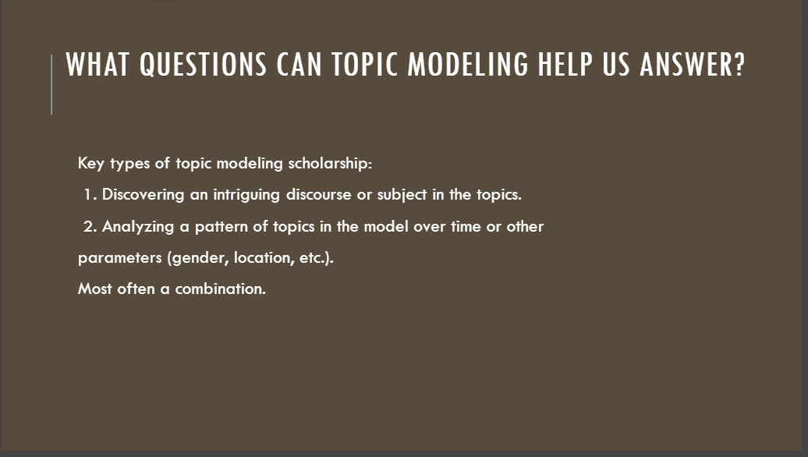
Terms can change over time. Topic modeling will group terms that mean the same into a topic.
Obese, stout

Slide 20
Topic Modeling Tool
Install TopicModelingTool.jar
It should be in the folder you downloaded.
Put it in Save2Here drive. Open it up.
Unzip texts.zip

Slide 21
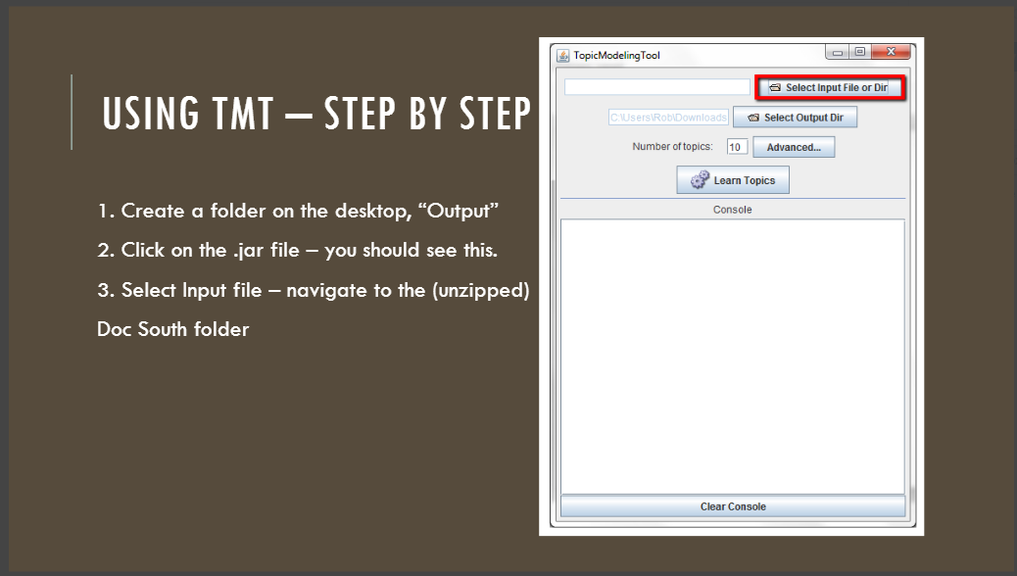

Slide 22
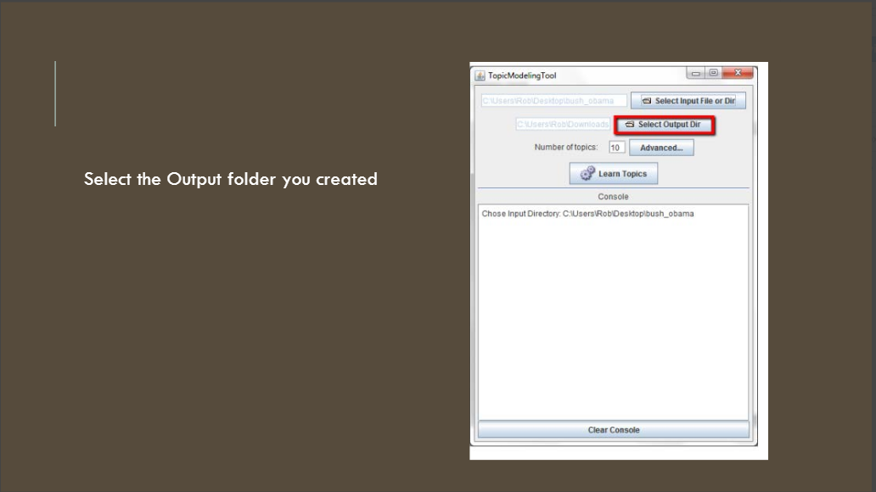

Slide 23
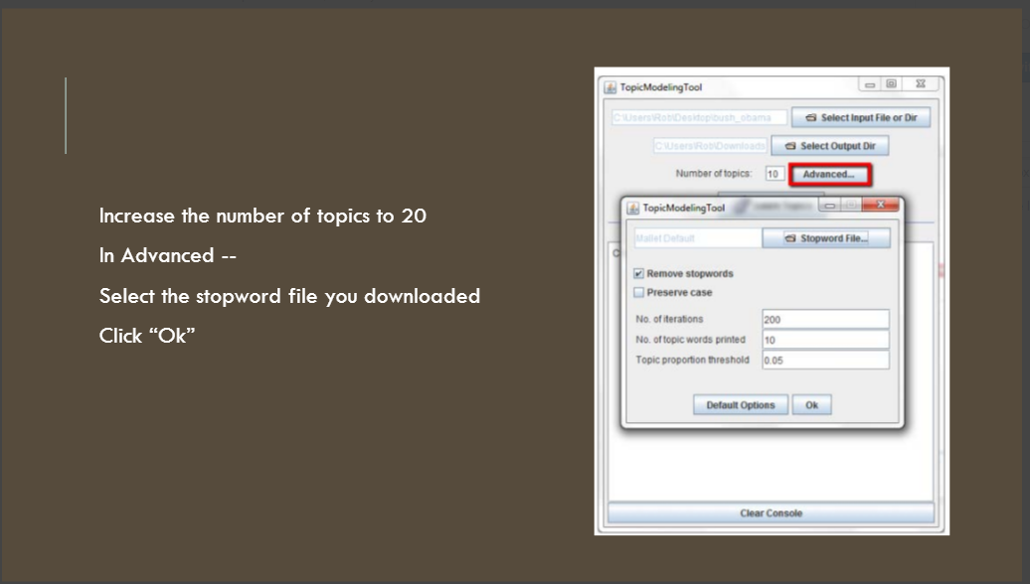

Slide 24
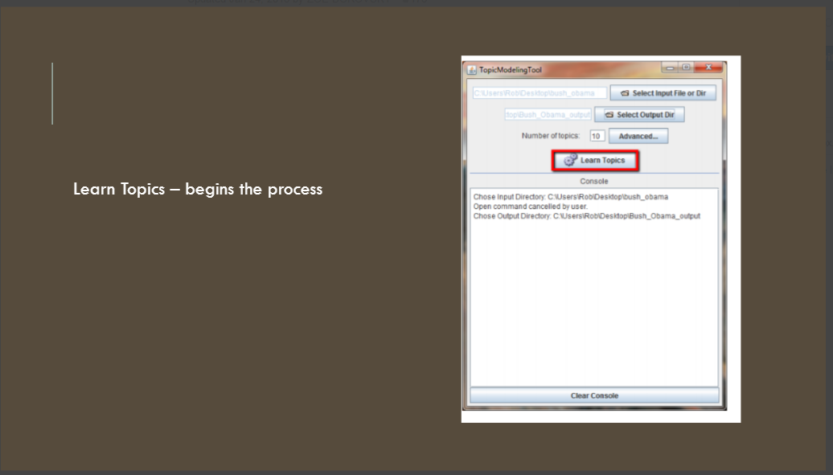

Slide 25
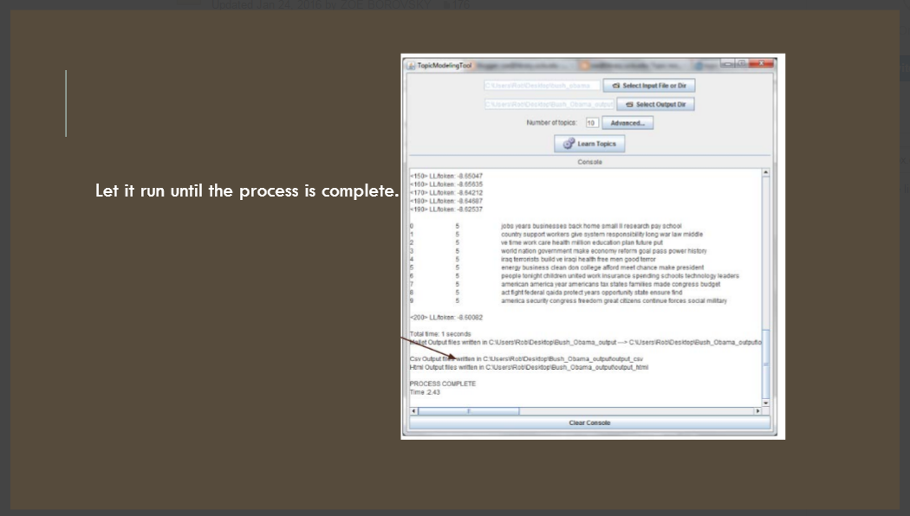

Slide 26
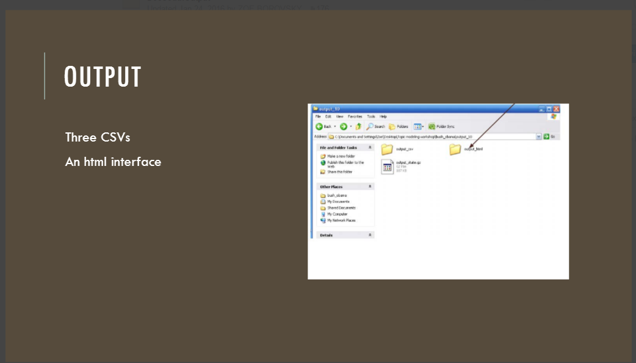

Slide 27
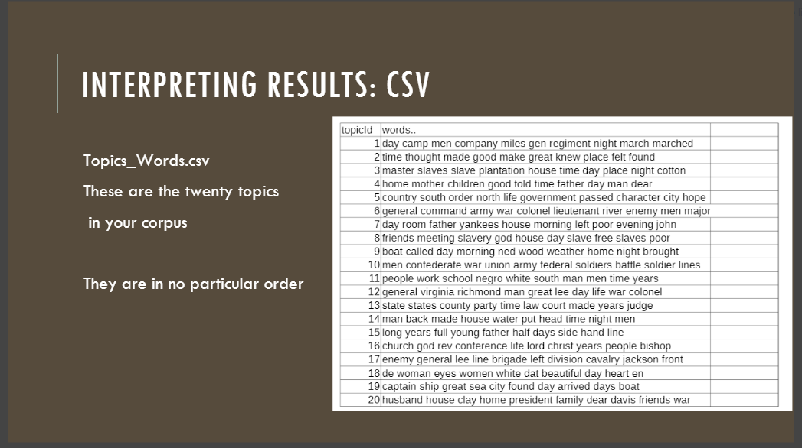

Slide 28
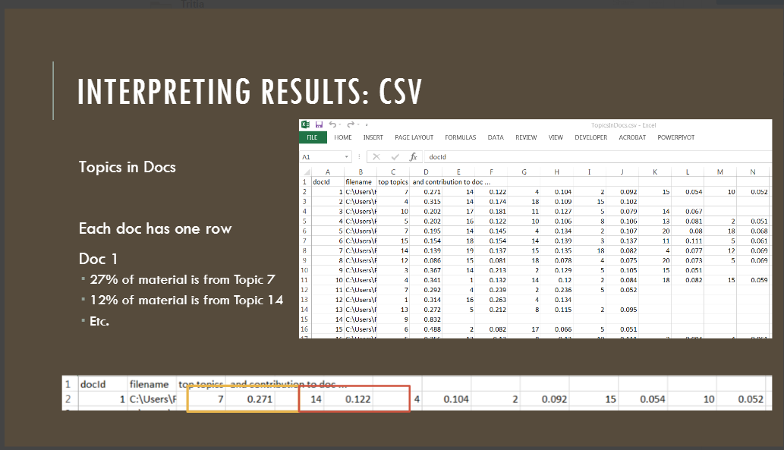

Slide 29
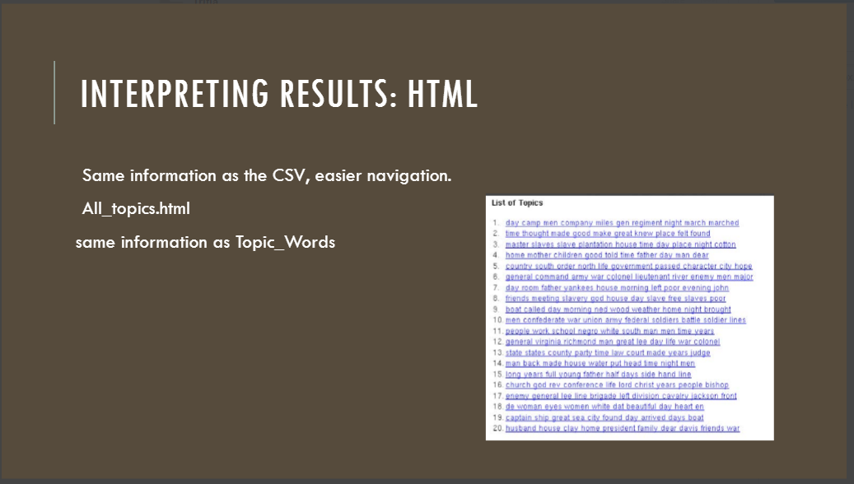

Slide 30
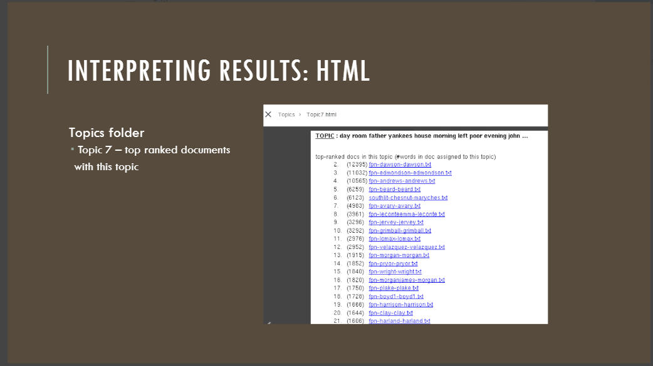

Slide 31
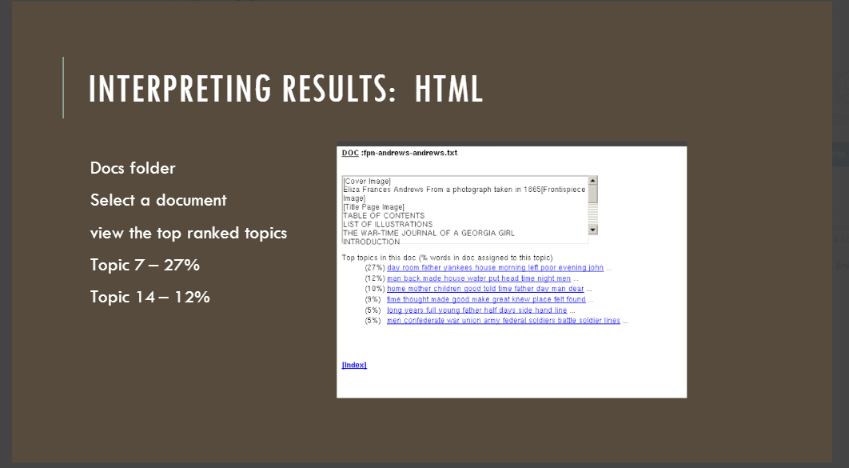

Slide 32
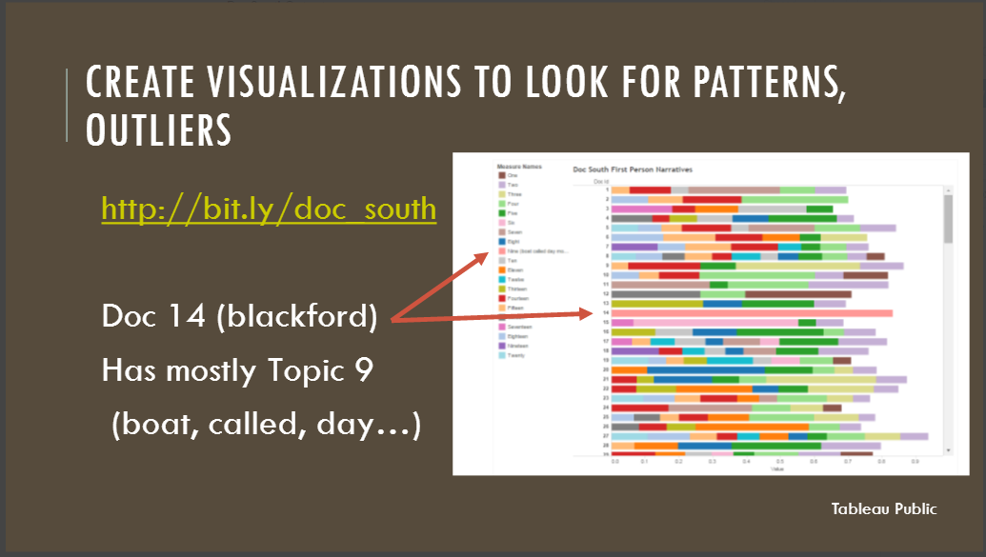

Slide 33
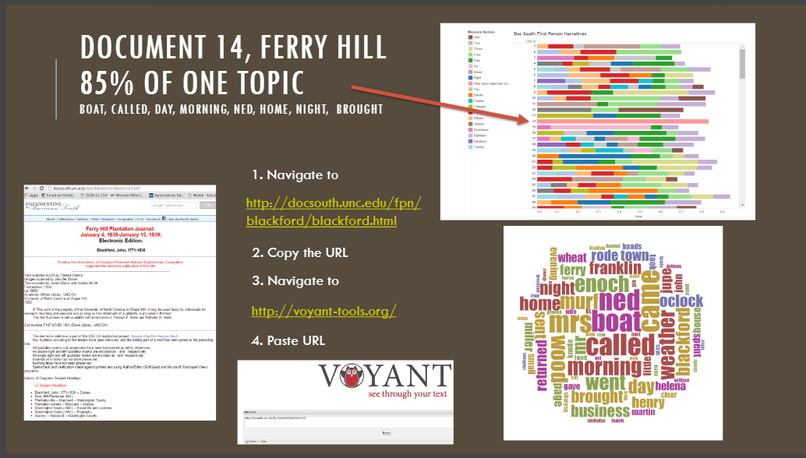
https://archive.org/stream/ferryhillplantat00blac/ferryhillplantat00blac_djvu.txt

Slide 34
What’s the difference?
Voyant/Voyeur
Mallet
Notes:
Tools that allow faculty/students to use computational methods.
There are much more sophisticated tools and methods, but we’re looking for quick and easy ways of testing hypotheses and exploring materials.

